Slide 1

Microsoft Project Blockbuster
Brendan M. Whittington

Slide 2
Summary
Our analysis shows an entry into the movie industry will need to come with a strong financial commitment and release strategy
There is a strong relationship between production costs and box office gross
There are key months where movies see the highest grosses
Audiences only marginally rate 3-D movies higher

Slide 3
Outline
Business Problem
Data & Methods
Results
Conclusion

Slide 4
Business Problem
Capital Allocation Decision
Timing Strategy
Creative / Genre Strategy

Slide 5
Data & Methods
Utilized data from IMDB and The Numbers
Looked at almost 4,000 movies among those over 200 3-D movies primarily since 2000
Focus was to include only movies during a similar cost of production period

Slide 6
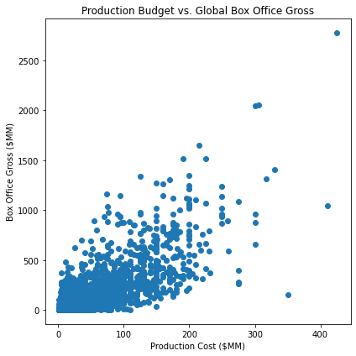
Results
There is a strong correlation of 0.77 between production budgets and the gross box office budget.

Slide 7
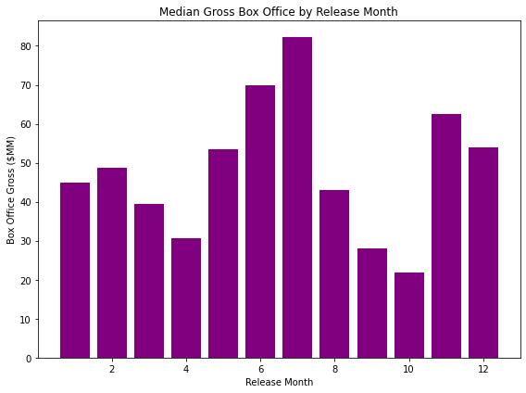
Results
There is strong seasonality in the movie release months. July is by far the most successful month whereas October is the worst.

Slide 8
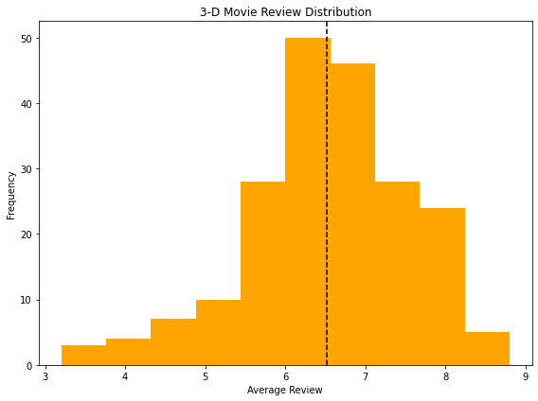
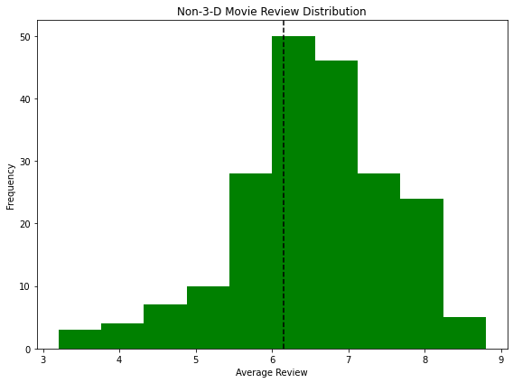
Results
The average movie that also has a 3-D release scores marginally higher than movies without the 3-D option.

Slide 9
Conclusion
Big budget movies tend to make more money than smaller ones
Movies show strong seasonality
There is marginally higher appeal toward 3-D
Next Steps:
Does “bigger is better” hold when including marketing budgets?
What are the returns on investments by month of release?
How much more money can one expect to make with a 3-D movie?

Slide 10
Thank You!
Email: brendanwhittington@gmail.com
GitHub: @Bmdubs88
LinkedIn: https://www.linkedin.com/in/brendanwhittington/

